Slide 1
What Are Digital Footprints?
Jennifer Ferguson
July 15, 2020
Advisory, HS 11th Grade

Slide 2
The PURPOSE of this lesson is for students to identify the “digital footprint” they create online through their use of apps, websites, games, activities… and the implications of their footprint for jobs and college entry.

Slide 3

Learning Objectives
Students will identify their digital footprints, by examining what apps they use, websites and social media they frequent and other “trails” they leave behind everyday.
● Students will recognize their activities that are traced, tracked, recorded or monitored on the internet.

Slide 4

Lesson GOALS
Students will monitor their digital usage for 24 hours by keeping a log of their activities.
● Students will gain a better understanding of their activities by creating a model of their daily “footprint” (drawing, map, etc).
● Students will reflect on their own digital footprint, and brainstorm ways to create a positive “digital presence.”

Slide 5

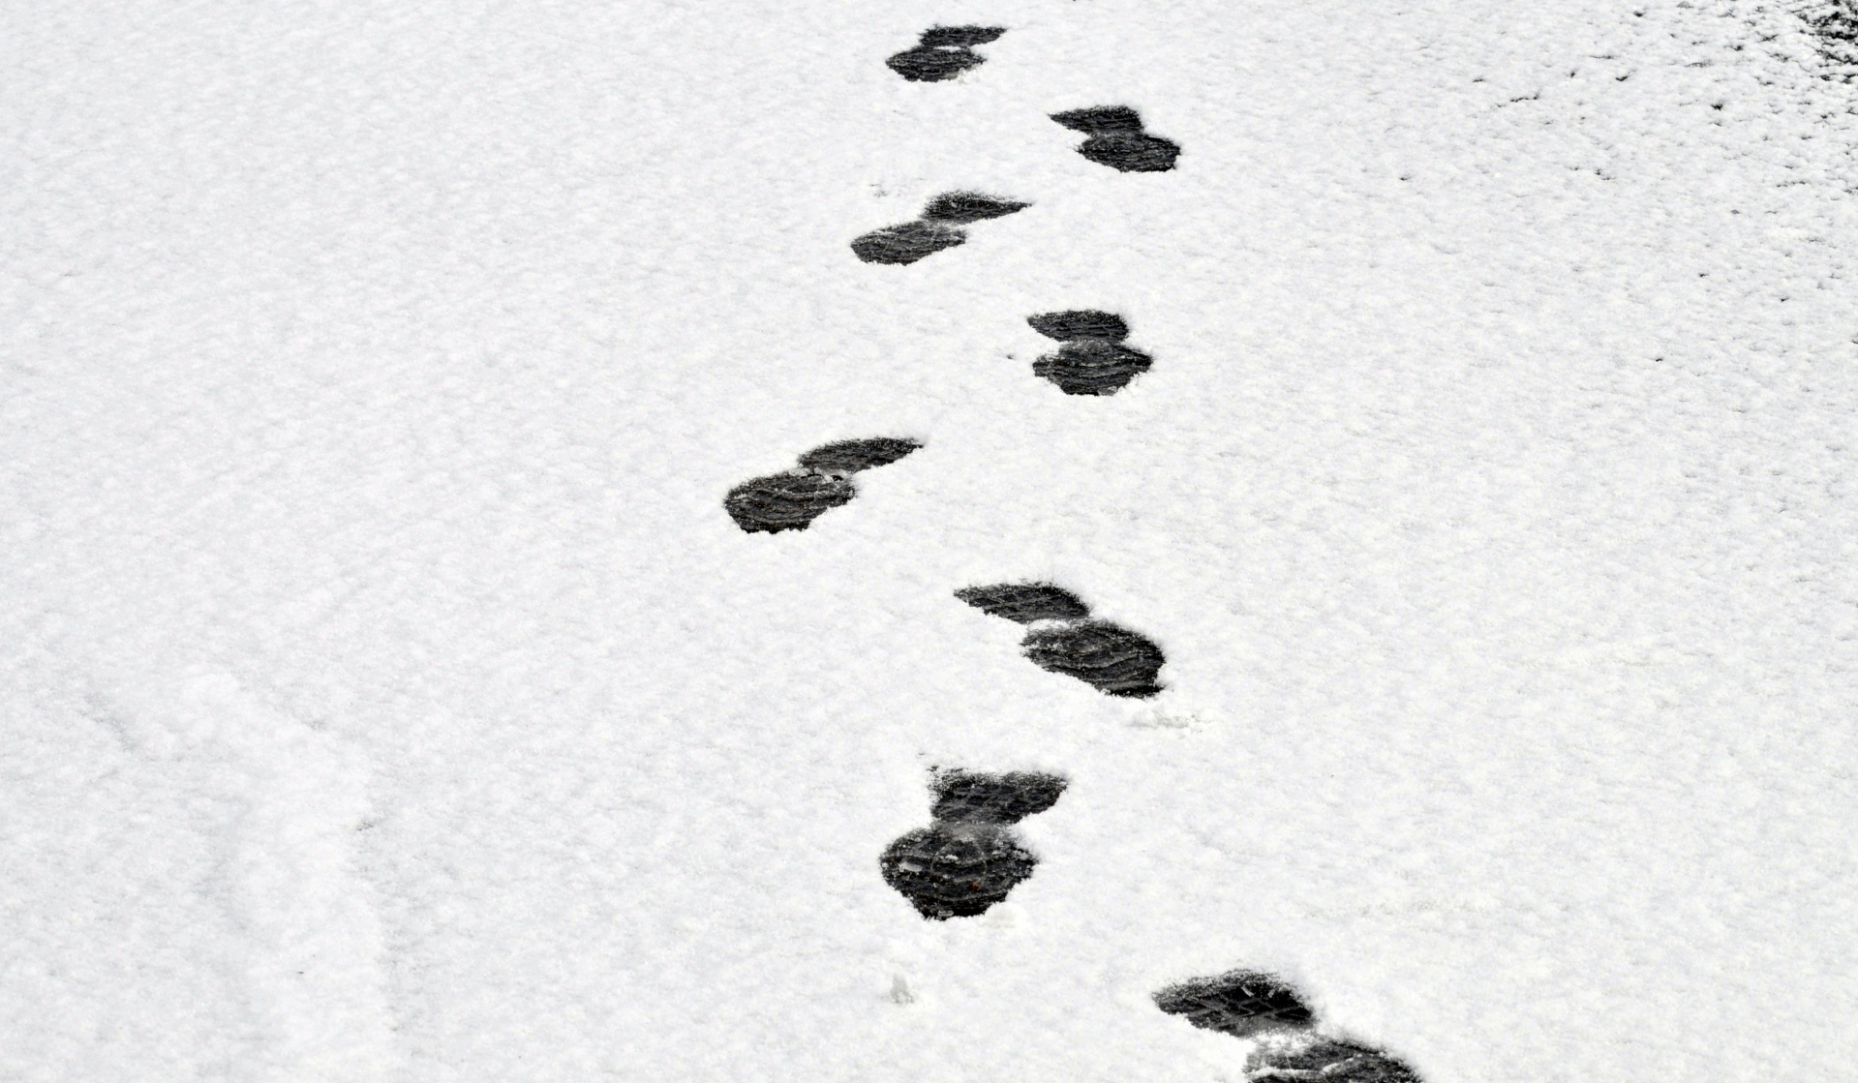
Think, Pair, Share
What is a digital footprint?
What would yours say about you? (3 min)

Slide 6
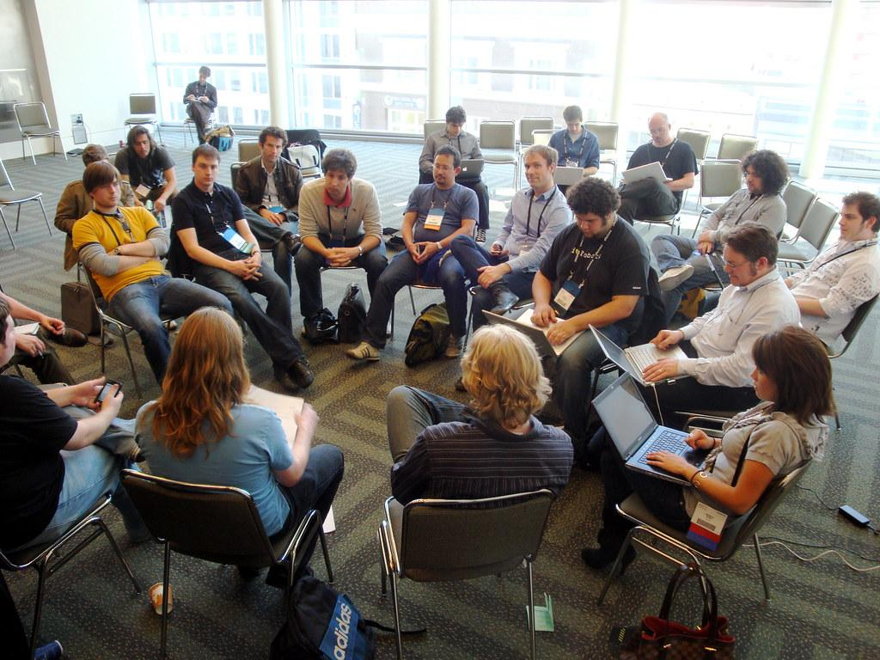
3 Minute Share Out

Slide 7

What is a digital footprint?
Notes:
https://docs.google.com/presentation/d/1ONgQp37TwsSJT4PshaeiLq-wkxjx4w6_h9AJWC0YhQ8/edit?usp=sharing

Slide 8
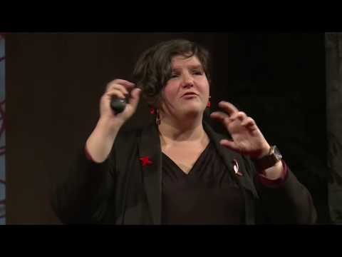
What does your digital footprint say about you?
Notes:
https://www.youtube.com/watch?v=RVX8ZSAR4OY

Slide 9
Small Group Discussion
In small groups, answer the following questions.
1. What does it mean that your digital footprint can be “searched”?
2. Think about three websites you use. Who sees the information you share on each of those sites?
3. What apps do you use regularly? What kind of information (permissions) do you allow your apps?
4. Because your footprint is permanent, information you share now might be seen in the future. If a college saw your digital footprint right now, do you think it would help or hurt your chances of getting in? Are there any ways you can create a more positive digital footprint?
5. Create a brief list of dos and don’ts for a more positive footprint.
Some questions courtesy of www.commonsensemedia.org/educators

Slide 10
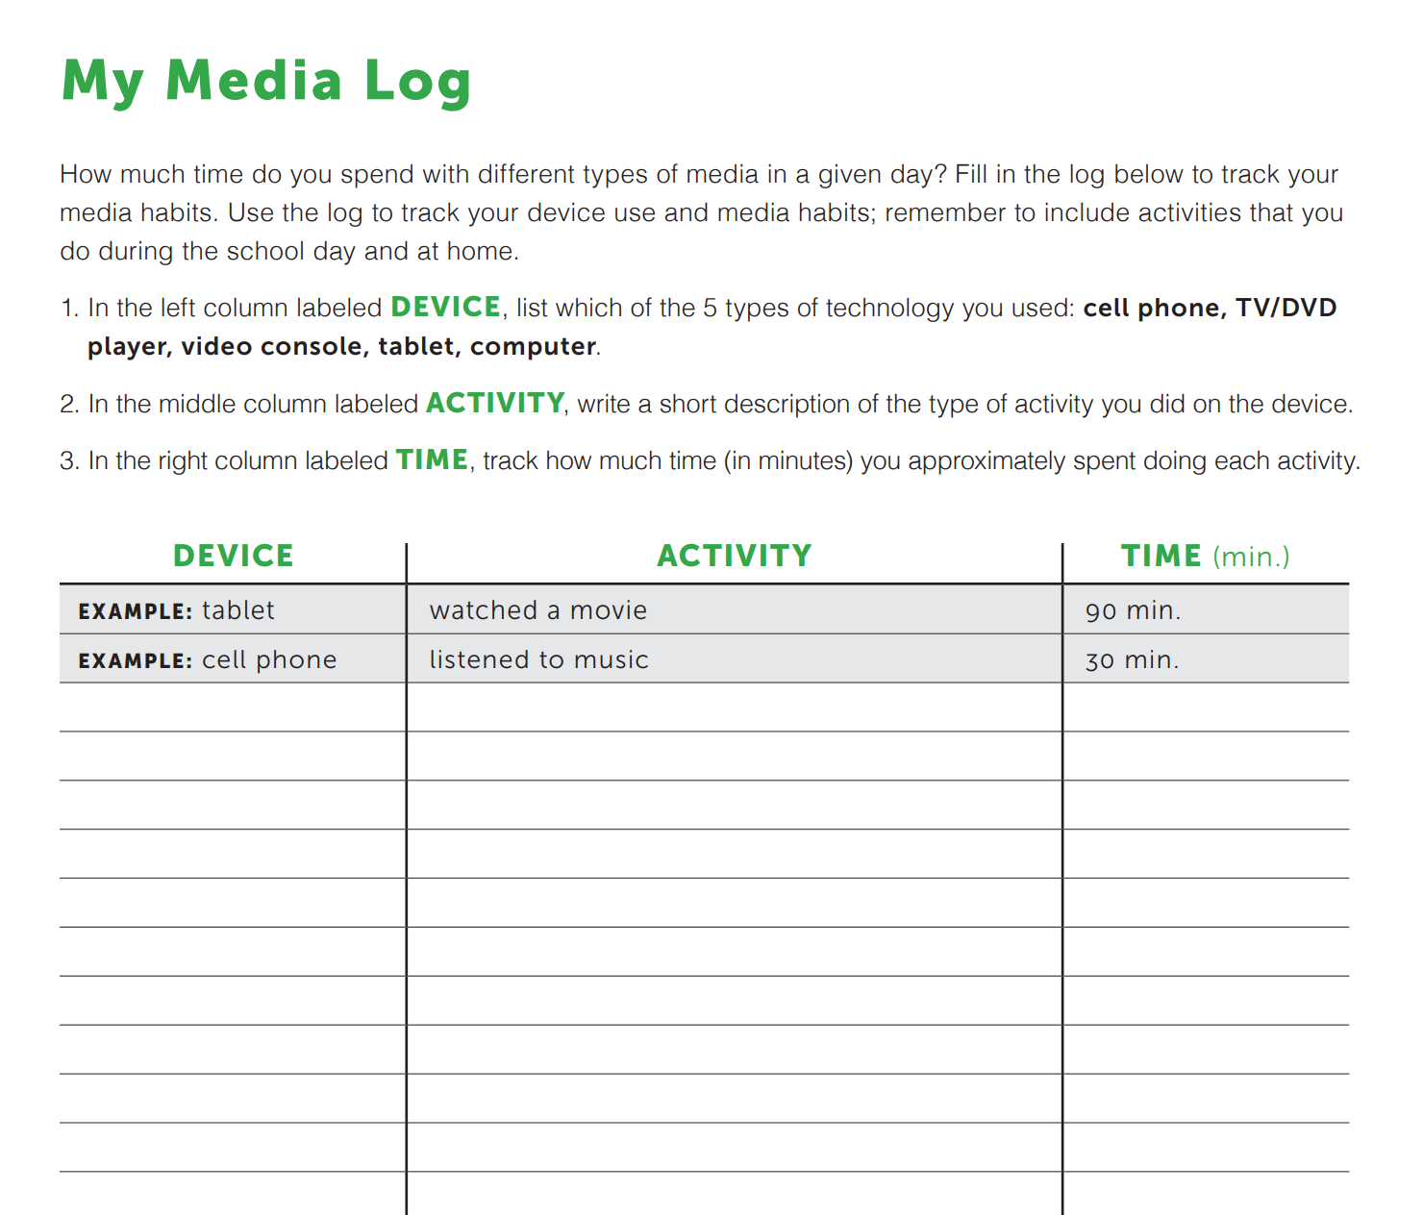
Your Assignment: The 24 Hour Digital Activity Log

Slide 11

The Take-Aways:
3-2-1 Exit Ticket
3 things you learned.
2 things you want to know more about.
1 thing you still have a question about.

Slide 12
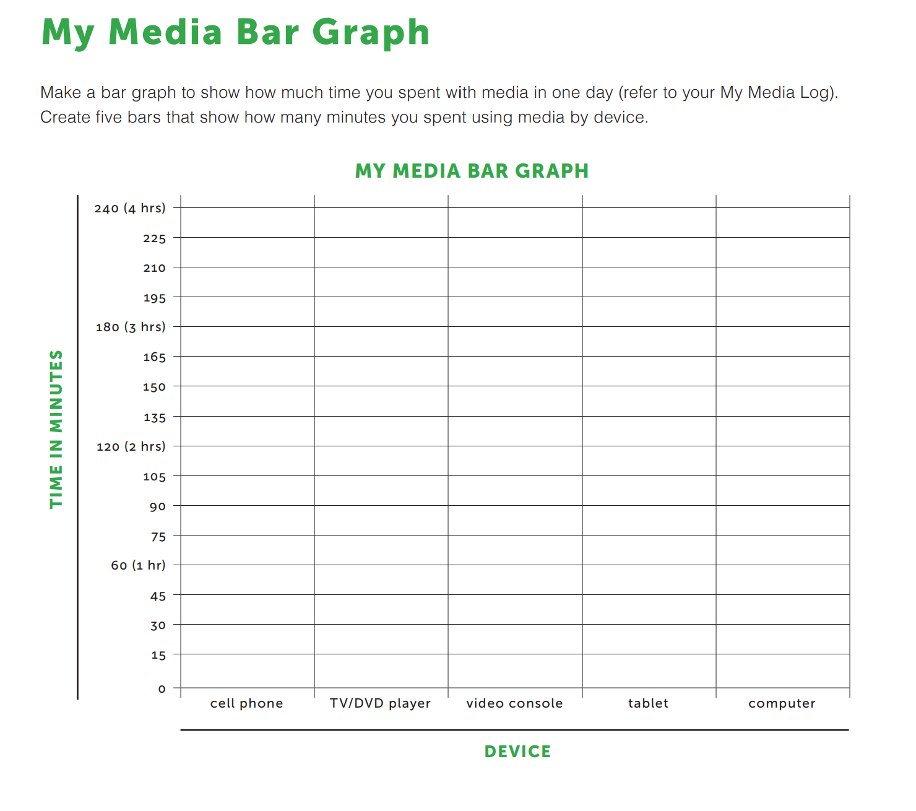
Assessment and Reflection
Activity Log Reflection: The student will assess their daily digital footprints by creating a graph of their usage..

Slide 13
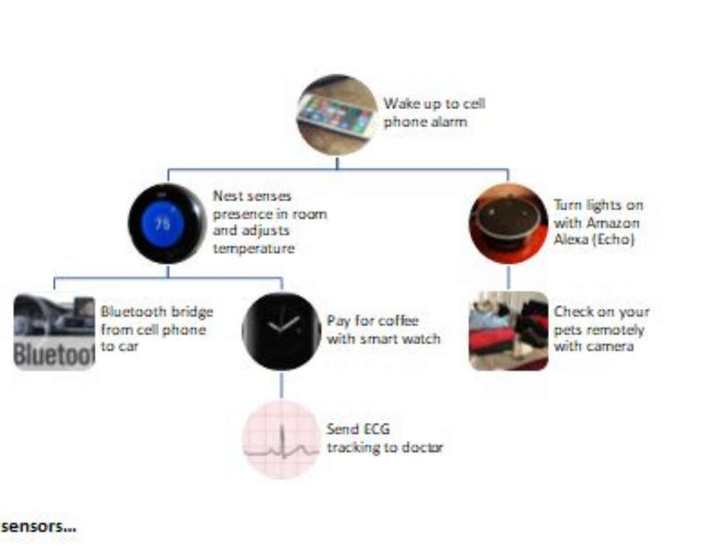
Reflection
Students create a model of their digital footprint. Models may vary, but can include a diagram, flow chart, drawing or mathematical model.

Slide 14
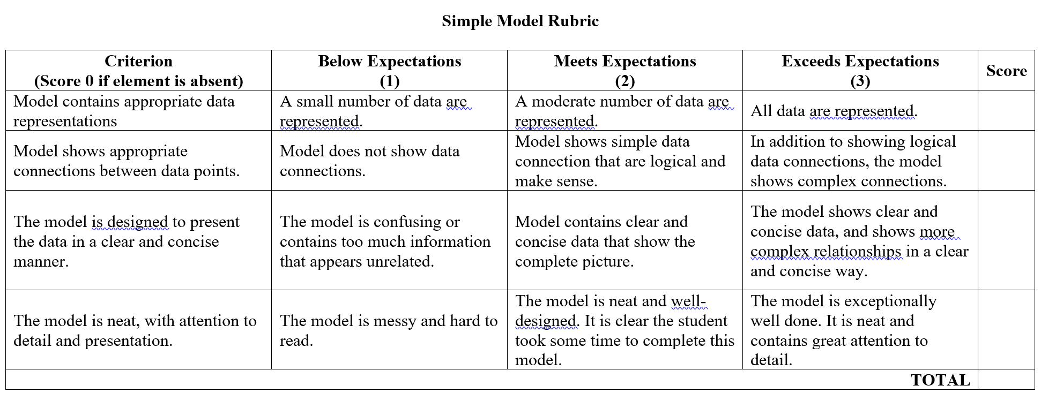
Model Rubric

Slide 15
References and Resources
Video: https://www.youtube.com/watch?v=RVX8ZSAR4OY
Commonsense digital media: https://www.commonsense.org/education/lesson-plans/whats-my-digital-footprint
Digital Activity Log https://www.commonsensemedia.org/sites/default/files/uploads/connecting_families/my_media_log.pdf
Model Rubric

